Slide 1

September Meeting
Zoom Meeting & 700 Governors Drive
9-12-2023 10:00 AM

Slide 2
Agenda

Slide 3
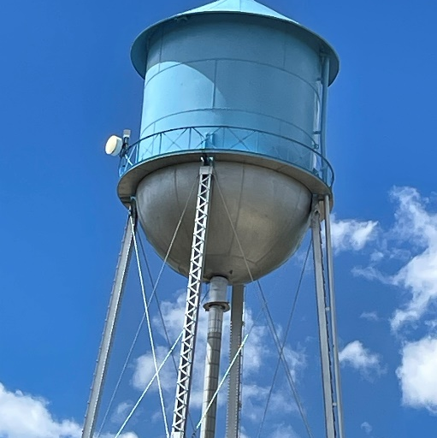
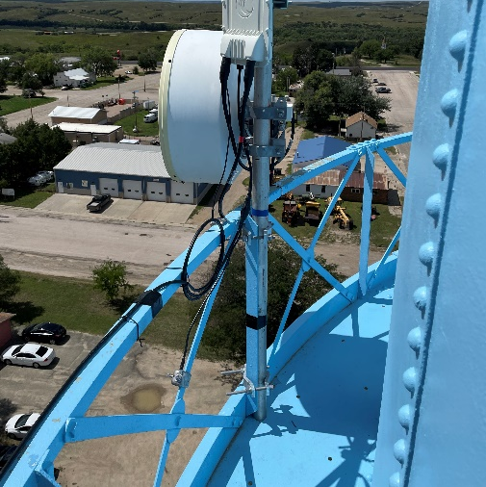
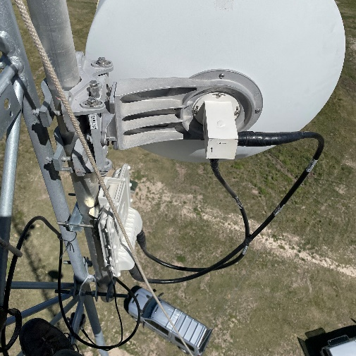
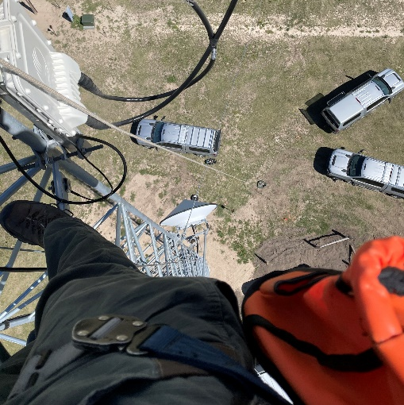
New Business
1. SWIC Updates – Todd Dravland (SWIC South Dakota)
2. System Upgrade Status – 18 sites to go
•Permit Challenges update – Golden West was unable to secure a permit from the BIA/Rosebud Sioux Tribe to bury fiber to the White River site. State Radio designed and implemented a contingency plan utilizing microwave to deploy a wireless backhaul link from the Mellette County Jail adjacent to the White River water Tower to the With Rive tower site location 11 miles south. We are hopeful that the permits get granted at some point in the future. Thanks to the City of White River and Mellette County for their excellent cooperation making this rapid deployment possible for the sake of public safety communications.
•Site upgrades completed for all direct connected PSAP/Dispatches and the following tower sites are now completed
•Visit STATERADIO.SD.GOV to track P25 upgrades

Slide 4
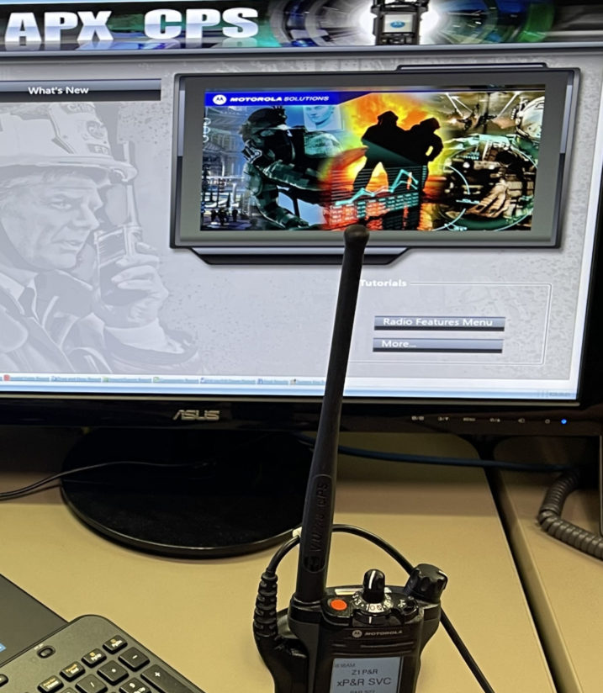
New Business (Continued)
3. Radio Programming Challenges – Looking towards the future and filling voids
  Recent P25 site upgrades have exposed some programming issues in the state
  Radio programming can potentially undermine the interoperability of the state radio system
  Recent retirements of radio vendors leaving gaps in radio service (especially in central SD)
  State Radio does not have the staff to develop code plugs and program all radios in the state. Like many agencies and vendors hiring/training RF technicians is very challenging.
  Explore possibility of using volunteers from Fire, EMS, Law, EM to program radios. Put together a plan to use these resources that have a vested interest in radio operation and interoperability.
  Things to consider – Recruiting volunteers, training, certification (ASK application

Slide 5
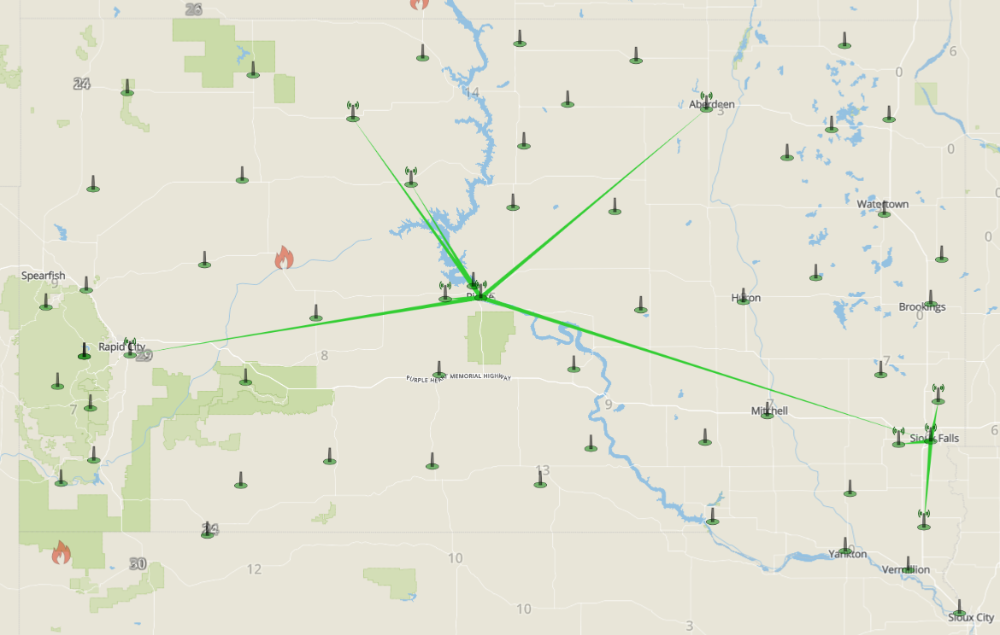
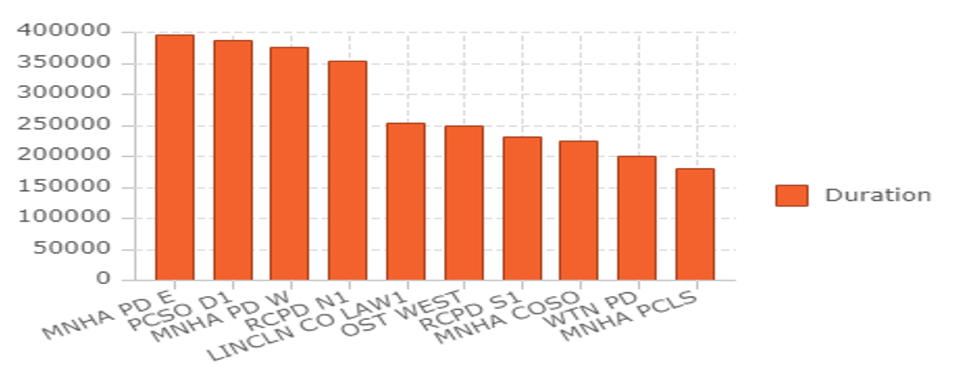
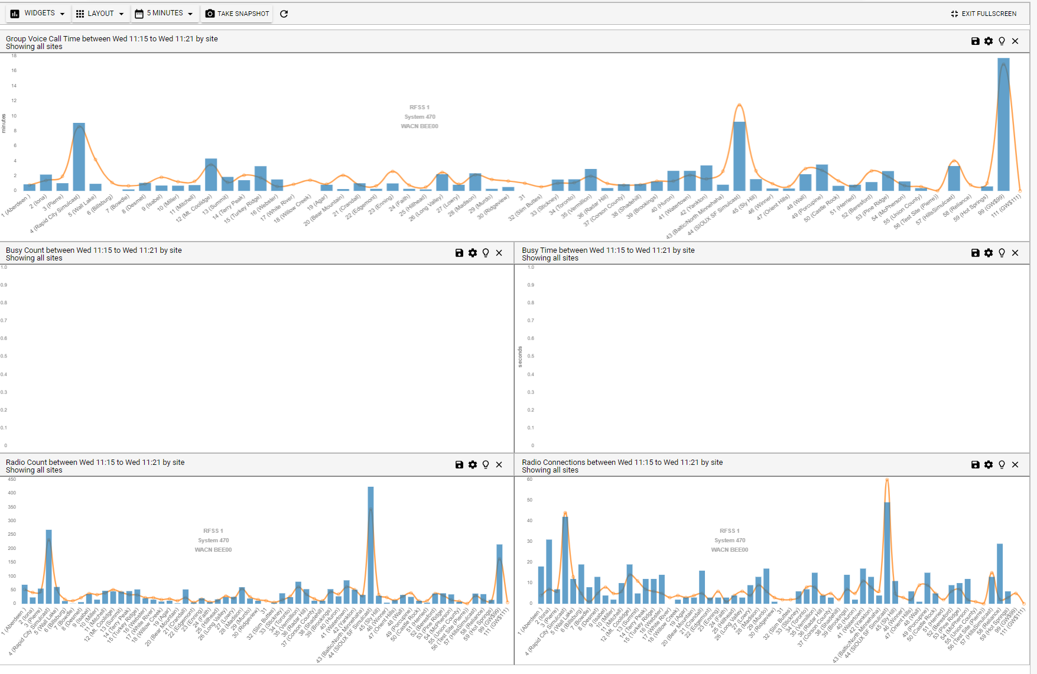
New Business (Continued)
4. Genesis Presentation
State Radio system Dashboard
Reporting
Live Call Map

Slide 6
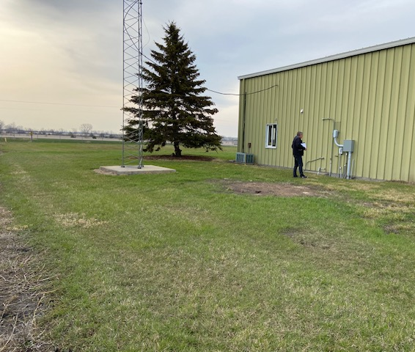
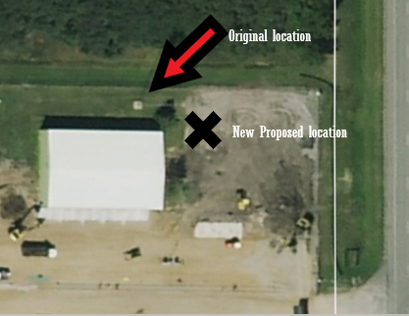
New Business (Continued)
5. Redfield/White River Projects
  The new site at the Redfield work has been delayed by wet site conditions and unknown sand-filled void discovered while excavations under the original planned tower site.
  New soil analysis tests to be performed at new proposed tower site adjacent to east side of the building. Spectrum has been licensed for the site, Motorola equipment has been received, antenna and feedlines have been received, generator is on order, and electrical work is completed at the site. New target date set for the Fall of 2023.
  The 250’ tower replacement at White River is now completed, tower has been erected and the old tower has been deconstructed and hauled away.
  Adding the replacement of the Isabel tower to this list of projects. It was constructed the same time as White River and needed to be replaced due to life expectancy of the tower reaching it capacity.

Slide 7
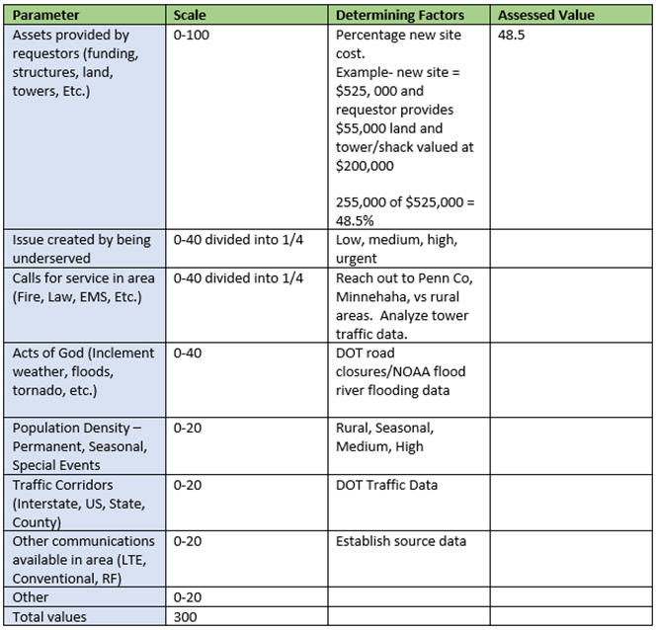
New Business (Continued)
6. Formula development for identifying underserved state radio coverage areas – open discussion
Added to this meeting Agenda per request at September 2022 meeting
Identify unserved and underserved areas of state radio coverage
Identify considerations and parameters to establish the priority level of unserved and underserved areas
The formula developed and adopted by SDPSCC will be used to request funding
A group was formed consisting of Nincehelser, Nachtigall, Pearson, Harrington, and Karley to identify the parameters used in identifying underserved areas for State Radio coverage in the state
The results of the meetings were that we identified several different parameters to consider represented by the table below

Slide 8
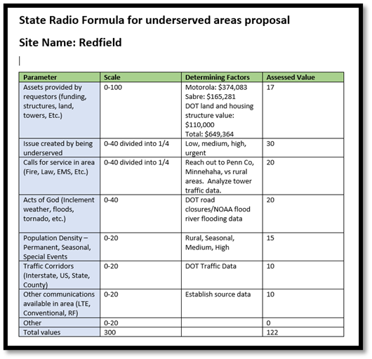
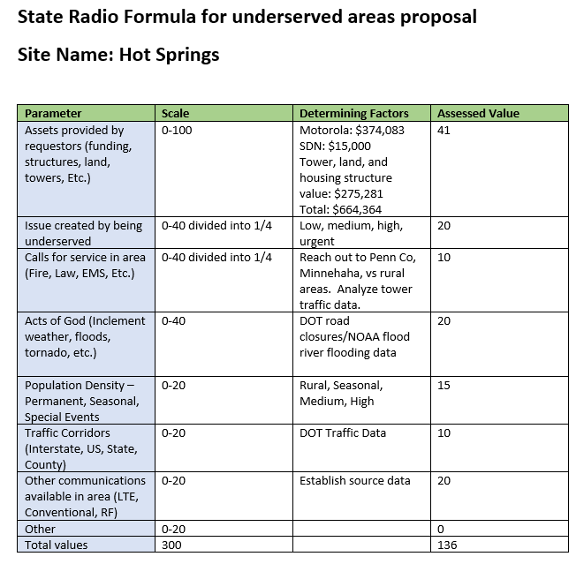
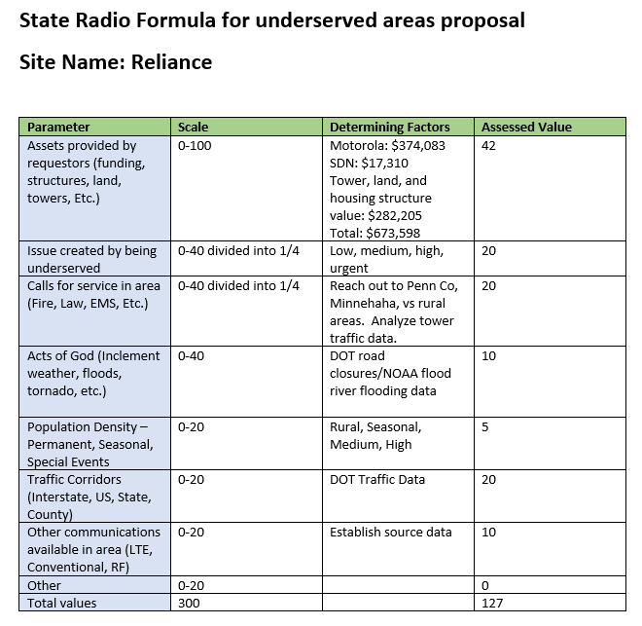
Examples of previous projects for review
Review Meade County proposal – James Johns

Slide 9
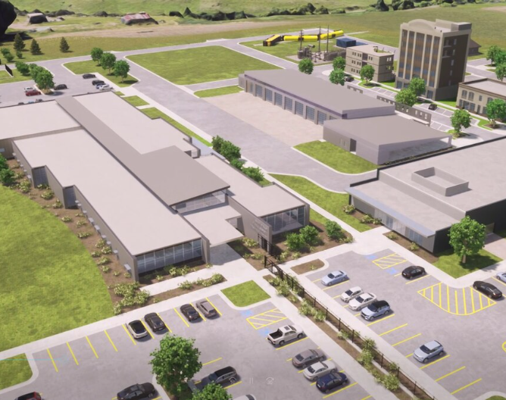
New Business (Continued)
7. Minnehaha County Projects – Matt Tooley
New Dispatch/Sioux Falls Public Safety Center – nearing completion
New simulcast system in 2024
8. Talkgroup Access Permission Form and Cache Radio Policy Review
Review and offer open discussion/suggest modifications
Intend to move to adopt in September meeting

Slide 10
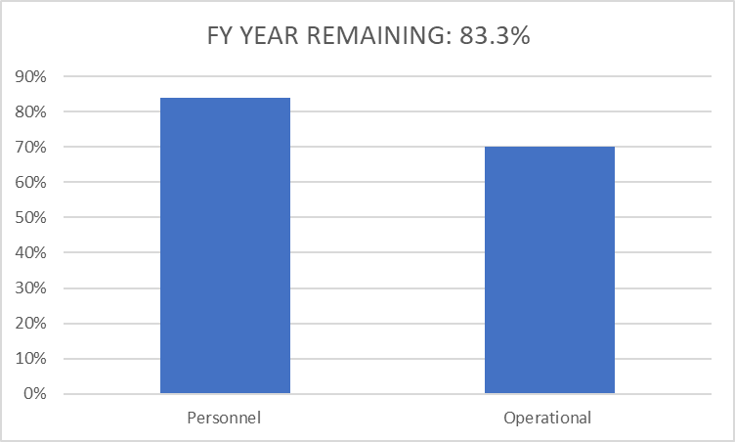
Old Business
Budget
Nearly 22% of total operational budget is paid in July for annual Motorola support contract
84% Personnel and 70% of Operational funds available

Slide 11

Old Business (Continued)
2. Broadband Subcommittee Report – Kendall Light
FirstNet Buildout Updates
3. Organization Representative Vacancies
Welcome Dave Kull and Brian Wacholz (interim)
911 and South Dakota Association of County Commissioners

Slide 12
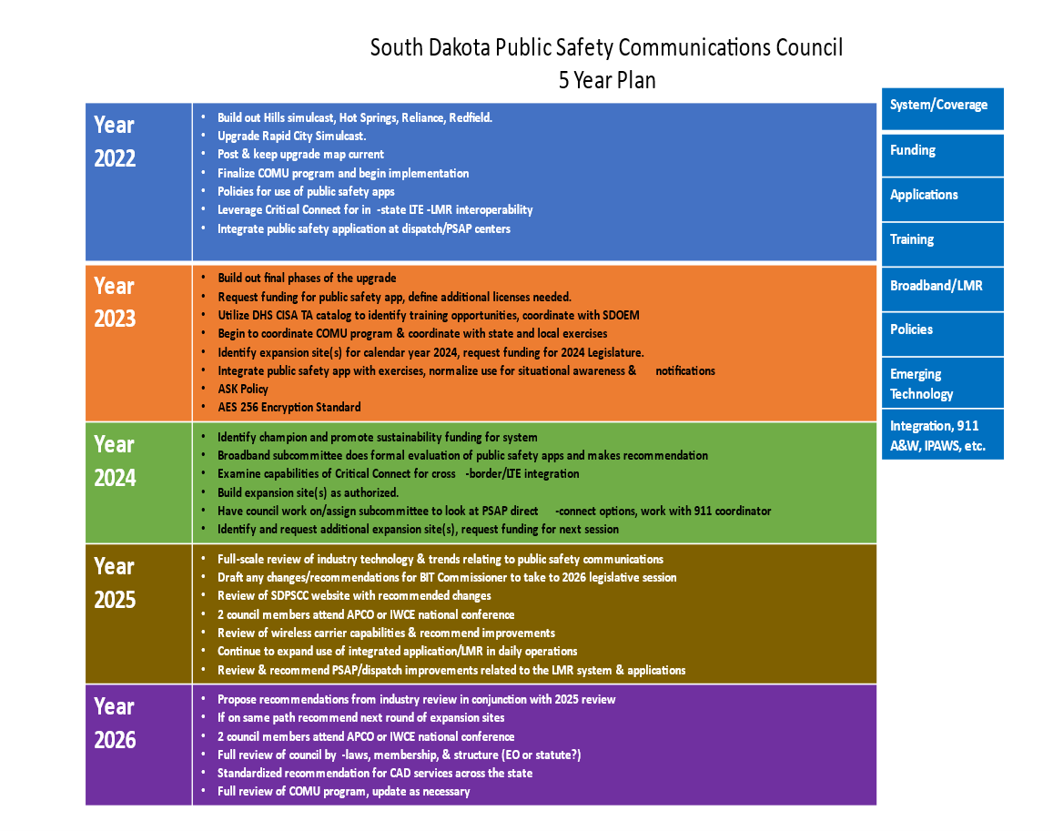
Old Business (Continued)
4. 5 Year Plan Review

Slide 13

Old Business (Continued)
5. AES Encryption Standard
Purchased AES 256 Encryption license from Motorola with EOY funds for dispatches
Regular meetings with CISA, Pennington County, Minnehaha County, and State Radio
Currently working on a Draft of the South Dakota Encryption Guide
We have identified, allocated, and registered 15 KID (Key ID) and CKR (Common Key Reference) numbers for the state issued by the National Law Enforcement Communications Center (NLECC) including a patch key for patching encrypted talkgroups to non-encrypted talkgroups
NLECC maintains a database of assigned keys to prevent key overlap and conflicts among interop agencies and provides a centralized, secure mechanism for receiving national interoperability keys and unique encryption keys.
We have reserved counties ranges of KIDs and CKR numbers as well
Goal to finalize adopt and start using AES 256 standard in Fall of 2023

Slide 14

Old Business (Continued)
6. Strategy for P25 upgrades 2023
Continue to effectively pass upgrade information to our affected agencies and organizations
Outreach and communications to state radio users appears to be successful – not hearing of very many user issues
Projected completion of site upgrades is November 19th, 2023
Thank you everyone for your efforts getting the word out to your organizations, it has had an impact!

Slide 15

Organizational Reports
Closing Comments
Vice-chair – Garrett Wellman
Member at Large - Kevin Karley
Chair – Bruce Nachtigall
Next Meeting: date, time, location

