Slide 1

June Meeting
Team Meeting & 700 Governors Drive
6-11-2025 10:00 AM

Slide 2
Agenda
10:00 AM Call Meeting to Order-
Roll Call of Members- Secretary
Additional Items to be added to agenda- Motorola offering 35% discount on LTE radios APX Next and N70 until June 27th – Contact state radio or Motorola dealer to take advantage of the excellent one-time opportunity!
Organizations
Police Chiefs Assn. – Jason Jones
Sheriff’s Assn – Steve Swenson
DCI/Attorney General – Preston Patterson
GFP – Bruce Nachtigall
DOT – Brian Wacholz
National Guard – David Goodwin
Emergency Managers – Pat Harrington
Firefighters – Charlie Kludt
Healthcare – Tim Rave
Highway Patrol – Micheal Peterson
APCO/NENA – Kevin Karley
EMT – Brent Long
Wildland Fire – Ray Black
County Commissioners – Kade Haley
Health Department – Vacant
Tribal Governments – Jim Pearson
Federal Government – Andy Barth
BIT Engineering – Trent Nincehelser
SD Senate – Vacant
SD House of Representatives – David Kull
911 – Jason Husby

Slide 3
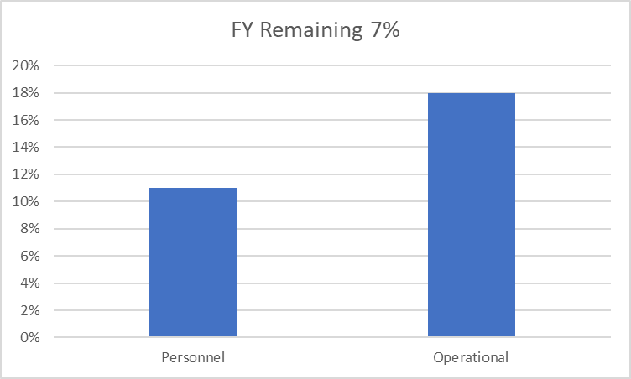
Old Business
Budget
Nearly 22% of total operational budget is paid in July for annual Motorola support contract
10.3% Personnel and 18% of Operational funds available

Slide 4

Old Business (Continued)
2. Broadband Subcommittee Report
FirstNet Updates
T-Mobile updates
3. Meade County I90 Corridor update
$46,000 funding appropriated for radio coverage study
Kicked off project in October
Surveys sent out to stakeholders in effort to gather data and feedback regarding radio operations in Meade County
RFCC provided written status report for legislature in January
RFCC performed dispatch tour, site inspections, coverage testing and hosted town hall meetings for input on February 18th
Determine next steps pending study results

Slide 5
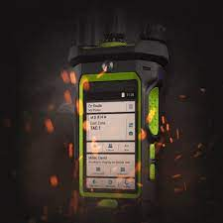
Old Business (Continued)
4. Minnehaha County Project updates
North Minnehaha Simulcast anticipated completion Q3 2025
Large purchase of LTE capable radios in Sioux Falls
5. Organization Representative Vacancies
SD Senate
Department of Health
Terms expire in June 2025 for several agencies
Seeking nominations for replacement or reinstatement for several agencies
Will work with Gov's office on pending appointments

Slide 6

New Business
1. SWIC Updates – Todd Dravland (SWIC South Dakota)
2. Sturgis site channel additions
Added two channels to Sturgis site
Completed in April
3. 85th Sturgis Rally Communications Plan
Lesson learned from last year
40% more RF capacity at Sturgis site
Special Ops channel as intercom between Pennington County Dispatch and Sturgis Dispatch for interop
LTE devices provided by FirstNet (40)
Wave apps as needed
DOT using Smart Connect base radio
HP using Smart Connect
Integrate Smart Connect Mobiles into Zetron Console via Max Gateway and 2 APX 6500 Motorola radios for Comms with restricted talkgroups
Sturgis Conventional channels
State Radio will meet with stakeholders to present/review final plan in July

Slide 7

New Business (continued)
4. Donated Pyramid Extenders and portables
Long range out of vehicle comms extenders
Agencies without AES encryption interop (not capable of end-to-end encryption)
Great application for rural operators such as fire, EMS, and unencrypted LE
5. Walworth County Radio Survey and Formula For Underserved Areas – Jeff Jensen (EM Walworth County)
Completed radio surveys sent out by State Radio
Radio Coverage Challenges/LTE Challenges
Scored Formula for Underserved in executive session - review and discussion
Scored 93 on the formula compared to recent requests of Spearfish (185 – in progress) and Meade County (105)
Potential RF site location for tower east of town
May need to see some local contributions to the effort to increase formula score

Slide 8

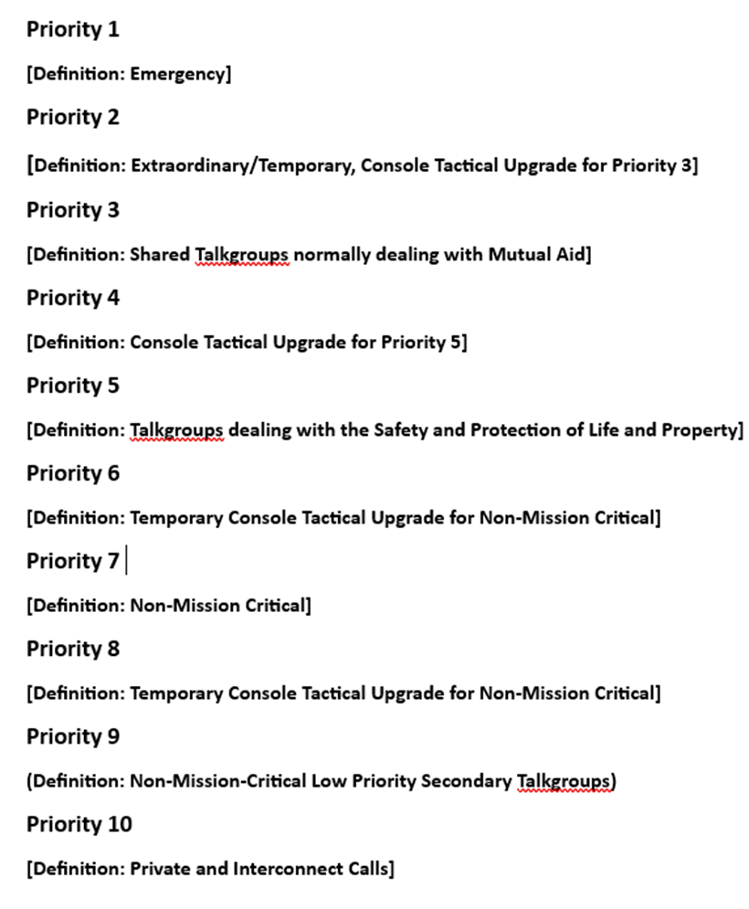
New Business (continued)
6. ISSI (Inter RF Subsystem Interface) cross border comms
Finalizing MOU with states beginning with Wyoming
Used available funds from state radio to cover costs
Auto roam should be fully operational soon
Contact State Radio to get access to interop Talkgroups
7. FirstNet buildout focus group update
Meeting every two weeks
Currently mapping RF coverage, LTE coverage, Calls for Service into GIS
Plan to give recommendations to priority areas for expension to all LTE providers this fall
8. Talkgroup prioritization policy review
Talkgroup prioritizations will help with capacity challenges and busies during times of high utilization such as Sturgis Rally
Prioritize Talkgroups (LE, Fire, EMS, Transit, DOT, Public Works, etc.)
Policy should be reviewed by SDPSCC members
Adopt prioritization policy in June meeting
Will require some PSAP training for upgrading priority

Slide 9

Organizational Reports
Organization Reports
Police Chiefs Assn. – Jason Jones
Sheriff’s Assn – Steve Swenson
DCI/Attorney General – Preston Patterson
GFP – Bruce Nachtigall
DOT – Brian Wacholz
National Guard – David Goodwin
Emergency Managers – Pat Harrington
Firefighters – Charlie Kludt
Healthcare – Tim Rave
Highway Patrol – Micheal Peterson
APCO/NENA – Kevin Karley
EMT – Brent Long
Wildland Fire – Ray Black
County Commissioners – Kade Haley
Health Department – Vacant
Tribal Governments – Jim Pearson
Federal Government – Andy Barth
BIT Engineering – Trent Nincehelser
SD Senate – Vacant
SD House of Representatives – David Kull
911 – Jason Husby
Closing Comments
Vice-chair – Lt. Michael Peterson
Member at Large - Kevin Karley
Chair – Bruce Nachtigall
Next Meeting: date, time, location – (Tentative) September 24th^{th}, 2025

