Slide 1
March Meeting
Team Meeting & 700 Governors Drive
3-12-25 10:00 AM

Slide 2
Agenda
10:00 AM Call Meeting to Order-
Roll Call of Members- Secretary
Additional Items to be added to agenda – Chuck Kevghas has retired. Thank you, Chuck, for your years of dedicated service to the SDPSCC!
Approve meeting minutes of December meeting
Organizations
Police Chiefs Assn. – Jason Jones
Sheriff’s Assn – Steve Swenson
DCI/Attorney General – Chad Mosteller
GFP – Bruce Nachtigall
DOT – Brian Wacholz
National Guard – David Goodwin
Emergency Managers – Pat Harrington
Firefighters – Charlie Kludt
Healthcare – Tim Rave
Highway Patrol – Micheal Peterson
APCO/NENA – Kevin Karley
EMT – Brent Long
Wildland Fire – Ray Black
County Commissioners – Kade Haley
Health Department – Vacant
Tribal Governments – Jim Pearson
Federal Government – Andy Barth
BIT Engineering – Trent Nincehelser
SD Senate – Vacant
SD House of Representatives – David Kull
911 – Jason Husby

Slide 3
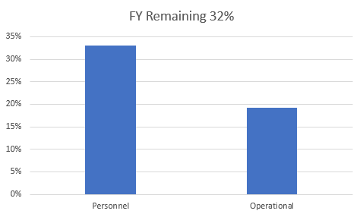
Old Business
Budget
Nearly 22% of total operational budget is paid in July for annual Motorola support contract
33% Personnel and 19% of Operational funds available

Slide 4
Old Business (Continued)
2. Broadband Subcommittee Report
FirstNet Buildout Updates
FirstNet Coverage Workshop January 30th
T-Mobile updates
3. Meade County I90 Corridor update
$46,000 funding appropriated for radio coverage study
Kicked off project in October
Surveys sent out to stakeholders in effort to gather data and feedback regarding radio operations in Meade County
RFCC provided written status report for legislature in January
RFCC performed dispatch tour, site inspections, coverage testing and hosted town hall meetings for input on February 18th
21 stakeholders attended meeting
RFCC should have study completed by April for review
Determine next steps pending study results

Slide 5
Old Business (Continued)
4. Minnehaha County Project updates
North Minnehaha Simulcast anticipated completion Q2 2025
Working closely with Sioux Falls to tackle challenges
Remote Radio Management planning/implementation
6. Organization Representative Vacancies
SD Senate
Department of Health
Working with Govs office on pending appointments

Slide 6
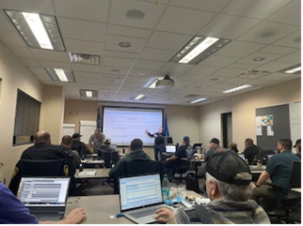
New Business
1. SWIC Updates – Todd Dravland (SWIC South Dakota)
2. State Radio APX programming Classes
First Class February 3-6, 2025
$750 per student
16 graduates of programming class
Free Bendix King Class hosted by State Radio Feb 13th
3.Sturgis site channel additions
Adding two channels to Sly Hill for capacity
May 2025 target completion
Meeting with Sturgis stakeholders to formulate Rally comms plan for 85th
4. Donated Wyoming Radios
35 available now (XTL5000 Mobile)
Over 200 radios already dispersed to DOT, SDGFP, OST, RST, and others
Contact State Radio to inquire about available radios
More will likely become available in the future

Slide 7
New Business (continued)
5. Walworth County Radio Survey and Formula For Underserved Areas – Jeff Jensen (EM Walworth County)
Completed radio surveys sent out by State Radio
Radio Coverage Challenges/LTE Challenges
6.FirstNet buildout focus group
Form focus group to review FirstNet Areas of Interest (AOI’s)
Identify areas in South Dakota where LTE and RF services are challenges
Prioritization
Provide findings of focus group to all LTE providers
Five-year plan obligation

Slide 8
New Business (continued)
7. Talkgroup prioritization policy review
Talkgroup prioritizations will help with capacity challenges and busies during times of high utilization such as Sturgis Rally
Prioritize Talkgroups (LE, Fire, EMS, Transit, DOT, Public Works, etc.)
Policy should be reviewed by SDPSCC members
Adopt prioritization policy in June meeting
Will require some PSAP training for upgrading priority

Slide 9
Organizational Reports
Organization Reports
Police Chiefs Assn. – Jason Jones
Sheriff’s Assn – Steve Swenson
DCI/Attorney General – Chad Mosteller
GFP – Bruce Nachtigall
DOT – Brian Wacholz
National Guard – David Goodwin
Emergency Managers – Pat Harrington
Firefighters – Charlie Kludt
Healthcare – Tim Rave
Highway Patrol – Micheal Peterson
APCO/NENA – Kevin Karley
EMT – Brent Long
Wildland Fire – Ray Black
County Commissioners – Kade Haley
Health Department – Vacant
Tribal Governments – Jim Pearson
Federal Government – Andy Barth
BIT Engineering – Trent Nincehelser
SD Senate – Vacant
SD House of Representatives – David Kull
911 – Jason Husby
Closing Comments
Vice-chair –
Member at Large - Kevin Karley
Chair – Bruce Nachtigall
Next Meeting: date, time, location – tentative June 11th, 2025

