Slide 1

March Meeting
Team Meeting & 700 Governors Drive
03-25-2026 10:00 AM

Slide 2
Agenda
10:00 AM Call Meeting to Order-
Roll Call of Members- Secretary
Additional Items to be added to agenda-David McVey to discuss the requirements of SDCL 1-25-13 (open meetings review)
Organizations
Police Chiefs Assn. – Jeremy Wellnitz
Sheriff’s Assn – Steve Swenson
DCI/Attorney General – Preston Patterson
GFP – Bruce Nachtigall
DOT – Brian Wacholz
National Guard – David Goodwin
Emergency Managers – Pat Harrington
Firefighters – Charlie Kludt
Healthcare – Jacob Parsons
Highway Patrol – Micheal Peterson
APCO/NENA – Mary Shoemaker
EMT – Robert Rendon
Wildland Fire – Ray Black
County Commissioners – Kade Haley
Health Department – Danielle Daak
Tribal Governments – Tommy Thompson
Federal Government – Andy Barth
BIT Engineering – Trent Nincehelser
SD Senate – Randy Deibert
SD House of Representatives – Kevin Van Diepen
911 – Jason Husby

Slide 3
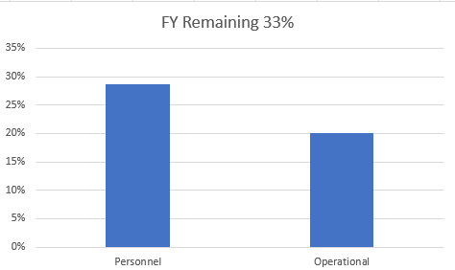
Old Business
Budget
Nearly 22% of total operational budget is paid in July for annual Motorola support contract
20% Personnel and 29% of Operational funds available

Slide 4

Old Business (Continued)
2. Broadband Subcommittee Report
  FirstNet Updates
  T-Mobile updates
3. Meade County I90 Corridor update
  $46,000 funding appropriated for radio coverage study
  Kicked off project in October
  Surveys sent out to stakeholders in effort to gather data and feedback regarding radio operations in Meade County
  RFCC provided written status report for legislature in January
  RFCC performed dispatch tour, site inspections, coverage testing and hosted town hall meetings for input on February 18th
  RFCC completed study and presented to Meade County Stakeholders
  Sent out final study to SDPSCC members
  Determine next steps in December meeting prior to legislative session
  State Radio response to RFCC study
  final action required

Slide 5
Old Business (Continued)
5. Organization Representative Vacancies
Emergency Manager Association- June
4. Minnehaha County Project updates
Working closely with Sioux Falls to tackle challenges with portable coverage
FCC frequency updates on Sioux Falls Simulcast system
State Radio staff optimizing sites in Minnehaha and Lincoln County to combat statistical high utilization and maintain Grade of Service

Slide 6
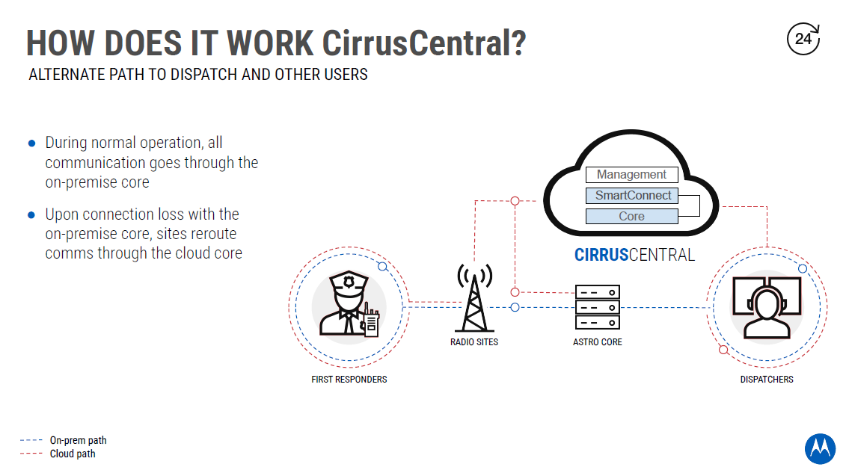
New Business
SWIC Updates- Todd Dravland has retired
Trent Nincehelser is now SWIC
Fed shutdown
More updates next meeting
2. CirrusCentral Redundant State Radio Core
$260,000/year
Protect against backhaul disruption
Protect against the failure of the State Radio Master Site
CirrusCentral can strengthen an existing ASTRO radio system by providing an alternate audio path between radio sites and dispatch. If the sites lose communication with the ASTRO core, they will automatically switch to the cloud-core, thereby enabling communication between users who are on cloud-provisioned sites connected to CirrusCentral.
CirrusCentral is geographically removed from local events or disasters that could take out your on-premise equipment.
The switch to CirrusCentral is automatic. Provisioned radio sites will automatically switch to the cloud-core when connections to the on-premise core is lost.
Funding approved, construction will begin soon

Slide 7

New Business (Continued)
3. Walworth County Radio Challenges – Jeff Jensen
  Completed radio surveys sent out by State Radio
  Radio Coverage Challenges/LTE Challenges
  Tested FirstNet, Verizon, and T-Mobile – all have issues with coverage
  Identified good location for new state radio site owned by MDU
  Offered site at no cost for public safety
  Walworth County seeking funds to retrofit tower to support State Radio antennas and feedlines ($37,290) and new shelter ($25,000)
  Increases Formula for Underserved Areas score from 93 to 124
  N70 testing feedback is good
  Explore funding options for remaining $544,000 if PSCC supports moving forward
  Motion to seek funding

Slide 8


New Business (Continued)
4. Brookings, Davison, Brown County – Coverage Challenges/updates
  Davison County moving forward with Siyata SD7 for portable coverage
  Brookings tested with great success plan to purchase 50 APX Next Radios
  Brown County will complete survey and state radio will soon send test equipment
5. Remote Radio Management – Kendall Light
  Feature purchase on radio
  Centrally Located Server
  Agencies can request pickup of programming equipment and work with state radio or vendors on codeplug development
  Codeplugs will be loaded on server for deployment
  Help with underserved areas for vendor support
  No technical expertise needed – just plug radio programming cable into radios and updates automatically load into radios
  Active now

Slide 9
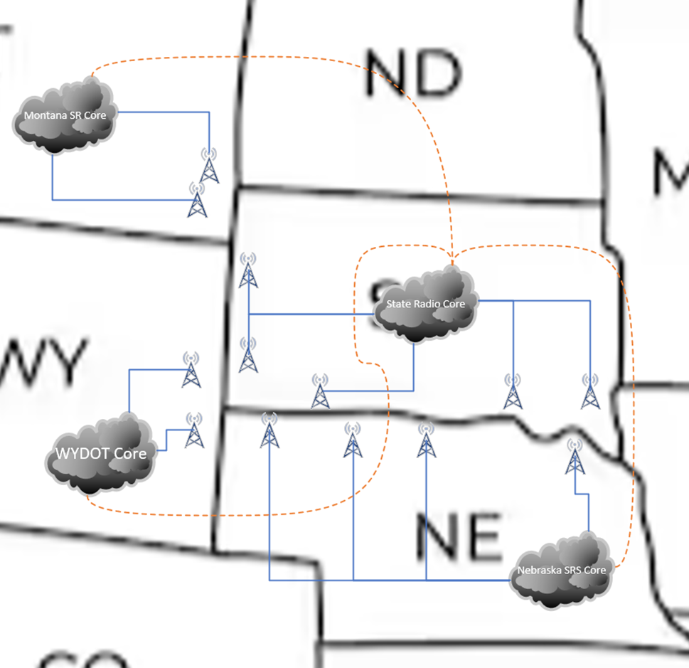
New Business (Continued)
6. ISSI (Inter-RF Subsystem Interface) – Kendall Light
South Dakota partnered with Wyoming, Montana, and Nebraska to form a multi-state ISSI (Inter RF Subsystem Interface) network.
Enables real-time interoperability during disasters, large events, and cross-border emergencies.
  Used successfully between Lawrence County (SD) and Crook County (WY) to locate missing persons in the Black Hills
  Wildfire response
  Cross-border law enforcement pursuits
  Search and rescue (SAR)
  Multi-casualty disaster coordination
  Daily use in underserved border areas
  Active Now with Wyoming – seeing significant coverage improvements in Black Hills

Slide 10
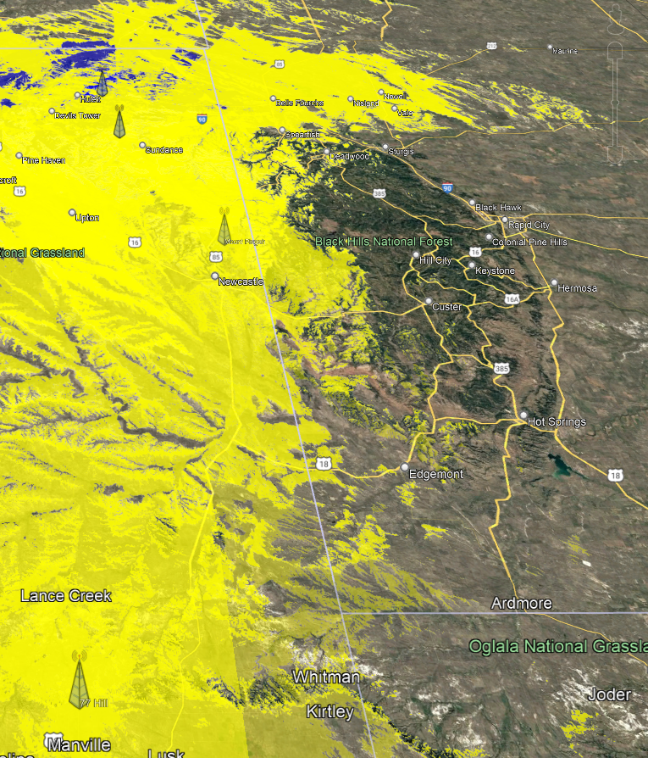
Predicted coverage from Wyoming towers into South Dakota using ISSI auto roam.

Slide 11
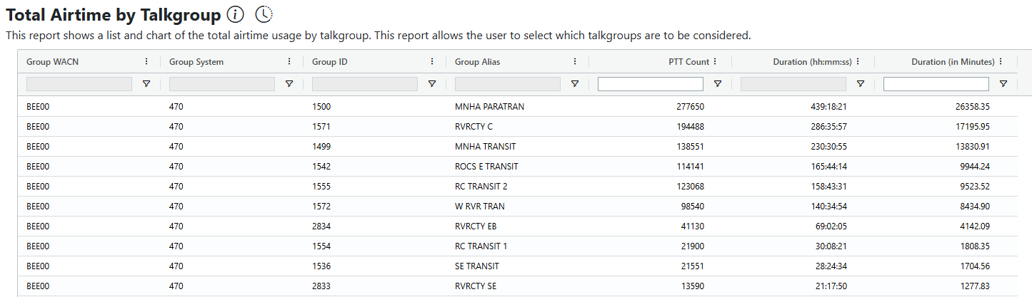
New Business (Continued)
Non-Mission Critical state radio user policy
The purpose of this policy is to define best practices and establish guidelines for non-mission critical users of the South Dakota State Radio system.
Applies to users such as transits, transportation, public works departments
Limit access to high utilization tower sites by talkgroups
Limit ability to roam statewide (regionalized access)
Limit access during emergency operations and special events (Sturgis)
Amend policy that all radios on the state radio system must have INT and SPECIAL OPS Talkgroups to eliminate access to INT talkgroups by non-mission critical users to SPECIAL OPS only and their specific assigned talkgroups
Lower priority on non-mission critical talkgroups
Priority will be determined by talkgroup access, not radio specific
Discuss potential to limit access to state radio RF system by non state agency, non-mission critical users by requiring the use of LTE/WIFI only devices in next 4 years
These efforts will ensure availability of radio resources during high utilization to mission critical responders
MNHA PARATRAN #16, RIVRCTY C #27, MNHA TRANSIT #32 in utilization across all Talkgroups
Inefficient dispatch practices/capabilities – mostly base radios
No cost sharing for State Radio system use currently

Slide 12
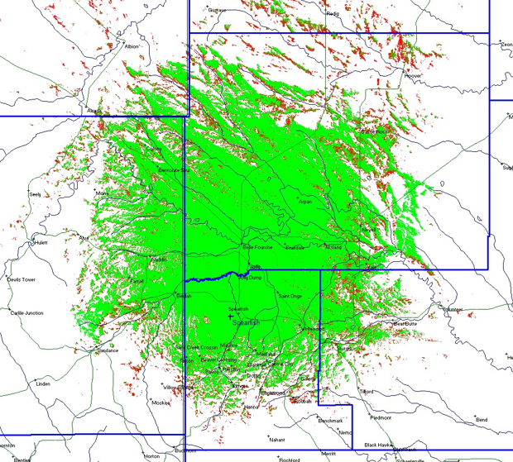
New Business (Continued)
8. PSAP Consoles update – Jason Husby
Winner
911 updates
9. New Spearfish Tower site
Live mid-February
Mobile Coverage along I90
Enhanced coverage into Spearfish Canyon
Outdoor portable coverage in Spearfish
Map depicts mobile (dash mount) radio coverage

Slide 13
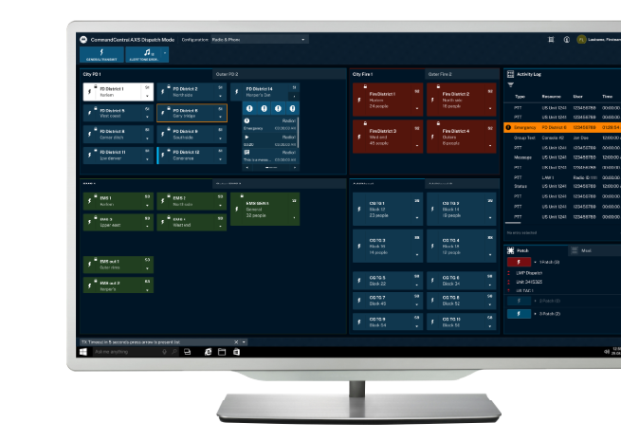
New Business (Continued)
10. Promotional Pricing on radios/consoles for 2026 – Katie Schloss
$35K off AXS Consoles through June
35% off N30, N50, N70, APX Next Radios in 2026
Use grant funds allocated for radios even if these are different make/model than applied for

Slide 14

Organizational Reports
Organization Reports
Police Chiefs Assn. – Jeremy Wellnitz
Sheriff’s Assn – Steve Swenson
DCI/Attorney General – Preston Patterson
GFP – Bruce Nachtigall
DOT – Brian Wacholz
National Guard – David Goodwin
Emergency Managers – Pat Harrington
Firefighters – Charlie Kludt
Healthcare – Jacob Parsons
Highway Patrol – Micheal Peterson
APCO/NENA – Mary Shoemaker
EMT – Robert Rendon
Wildland Fire – Ray Black
County Commissioners – Kade Haley
Health Department – Danielle Daak
Tribal Governments – Tommy Thompson
Federal Government – Andy Barth
BIT Engineering – Trent Nincehelser – Radio programmer classes April 13-17 or May 18-22
SD Senate – Randy Deibert
SD House of Representatives – Kevin Van Diepen
911 – Jason Husby
Closing Comments
Vice-chair – Michael Peterson
Member at Large - Vacant
Chair – Bruce Nachtigall
Next Meeting: date, time, location – Tentative June 9, 2026

