Slide 1

September Meeting
Team Meeting & 700 Governors Drive
9-24-25 10:00 AM

Slide 2
Agenda
10:00 AM Call Meeting to Order-
Roll Call of Members- Secretary
Additional Items to be added to agenda- Rogers Two Way asking for exception to policy for ASK request to program
Organizations
Police Chiefs Assn. – Jeremy Wellnitz
Sheriff’s Assn – Steve Swenson
DCI/Attorney General – Preston Patterson
GFP – Bruce Nachtigall
DOT – Brian Wacholz
National Guard – David Goodwin
Emergency Managers – Pat Harrington
Firefighters – Charlie Kludt
Healthcare – Jacob Parsons
Highway Patrol – Micheal Peterson
APCO/NENA – Mary Shoemaker
EMT – Robert Rendon
Wildland Fire – Ray Black
County Commissioners – Kade Haley
Health Department – Danielle Daak
Tribal Governments – Tommy Thompson
Federal Government – Andy Barth
BIT Engineering – Trent Nincehelser
SD Senate – Randy Deibert
SD House of Representatives – Kevin Van Diepen
911 – Jason Husby

Slide 3
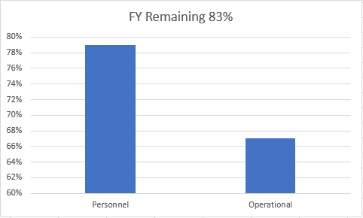
Old Business
Budget
Nearly 22% of total operational budget is paid in July for annual Motorola support contract
79% Personnel and 67% of Operational funds available

Slide 4

Old Business (Continued)
2. Broadband Subcommittee Report
  FirstNet Updates
  T-Mobile updates
3. Meade County I90 Corridor update
  $46,000 funding appropriated for radio coverage study
  Kicked off project in October
  Surveys sent out to stakeholders in effort to gather data and feedback regarding radio operations in Meade County
  RFCC provided written status report for legislature in January
  RFCC performed dispatch tour, site inspections, coverage testing and hosted town hall meetings for input on February 18th
  RFCC completed study and presented to Meade County Stakeholders
  Send out final study to SDPSCC members
  Determine next steps in December meeting prior to legislative session

Slide 5
Old Business (Continued)
North Minnehaha Simulcast anticipated completion October 2025
Working closely with Sioux Falls to tackle challenges with portable coverage
City of Sioux Falls and Minnehaha County ordered APX Next and APX N70 LTE capable radios
5. Organization Representative Vacancies
Many new appointees- currently no vacancies
Working with the Governors office on finalization
Introductions – Welcome aboard and thank you for your service to the SDPSCC!
Police Chiefs Assn. – Jeremy Wellnitz
Healthcare – Jacob Parsons
APCO/NENA – Mary Shoemaker
EMT – Robert Rendon
Health Department – Danielle Daak
Tribal Governments – Tommy Thompson
SD Senate – Randy Deibert
SD House of Representatives – Kevin Van Diepen
4. Minnehaha County Project updates

Slide 6

New Business
1. SWIC Updates – Todd Dravland (SWIC South Dakota)
2. BRINC Drones- A New Era of Response – Greg Ehrsam(field demonstration)
3.Spearfish Site Addition
Adding four channel site in Spearfish
Provide portable coverage to Spearfish area
4. 85th Sturgis Motorcycle Rally success story
January 2026 target completion
Provide Mobile coverage along I90

Slide 7
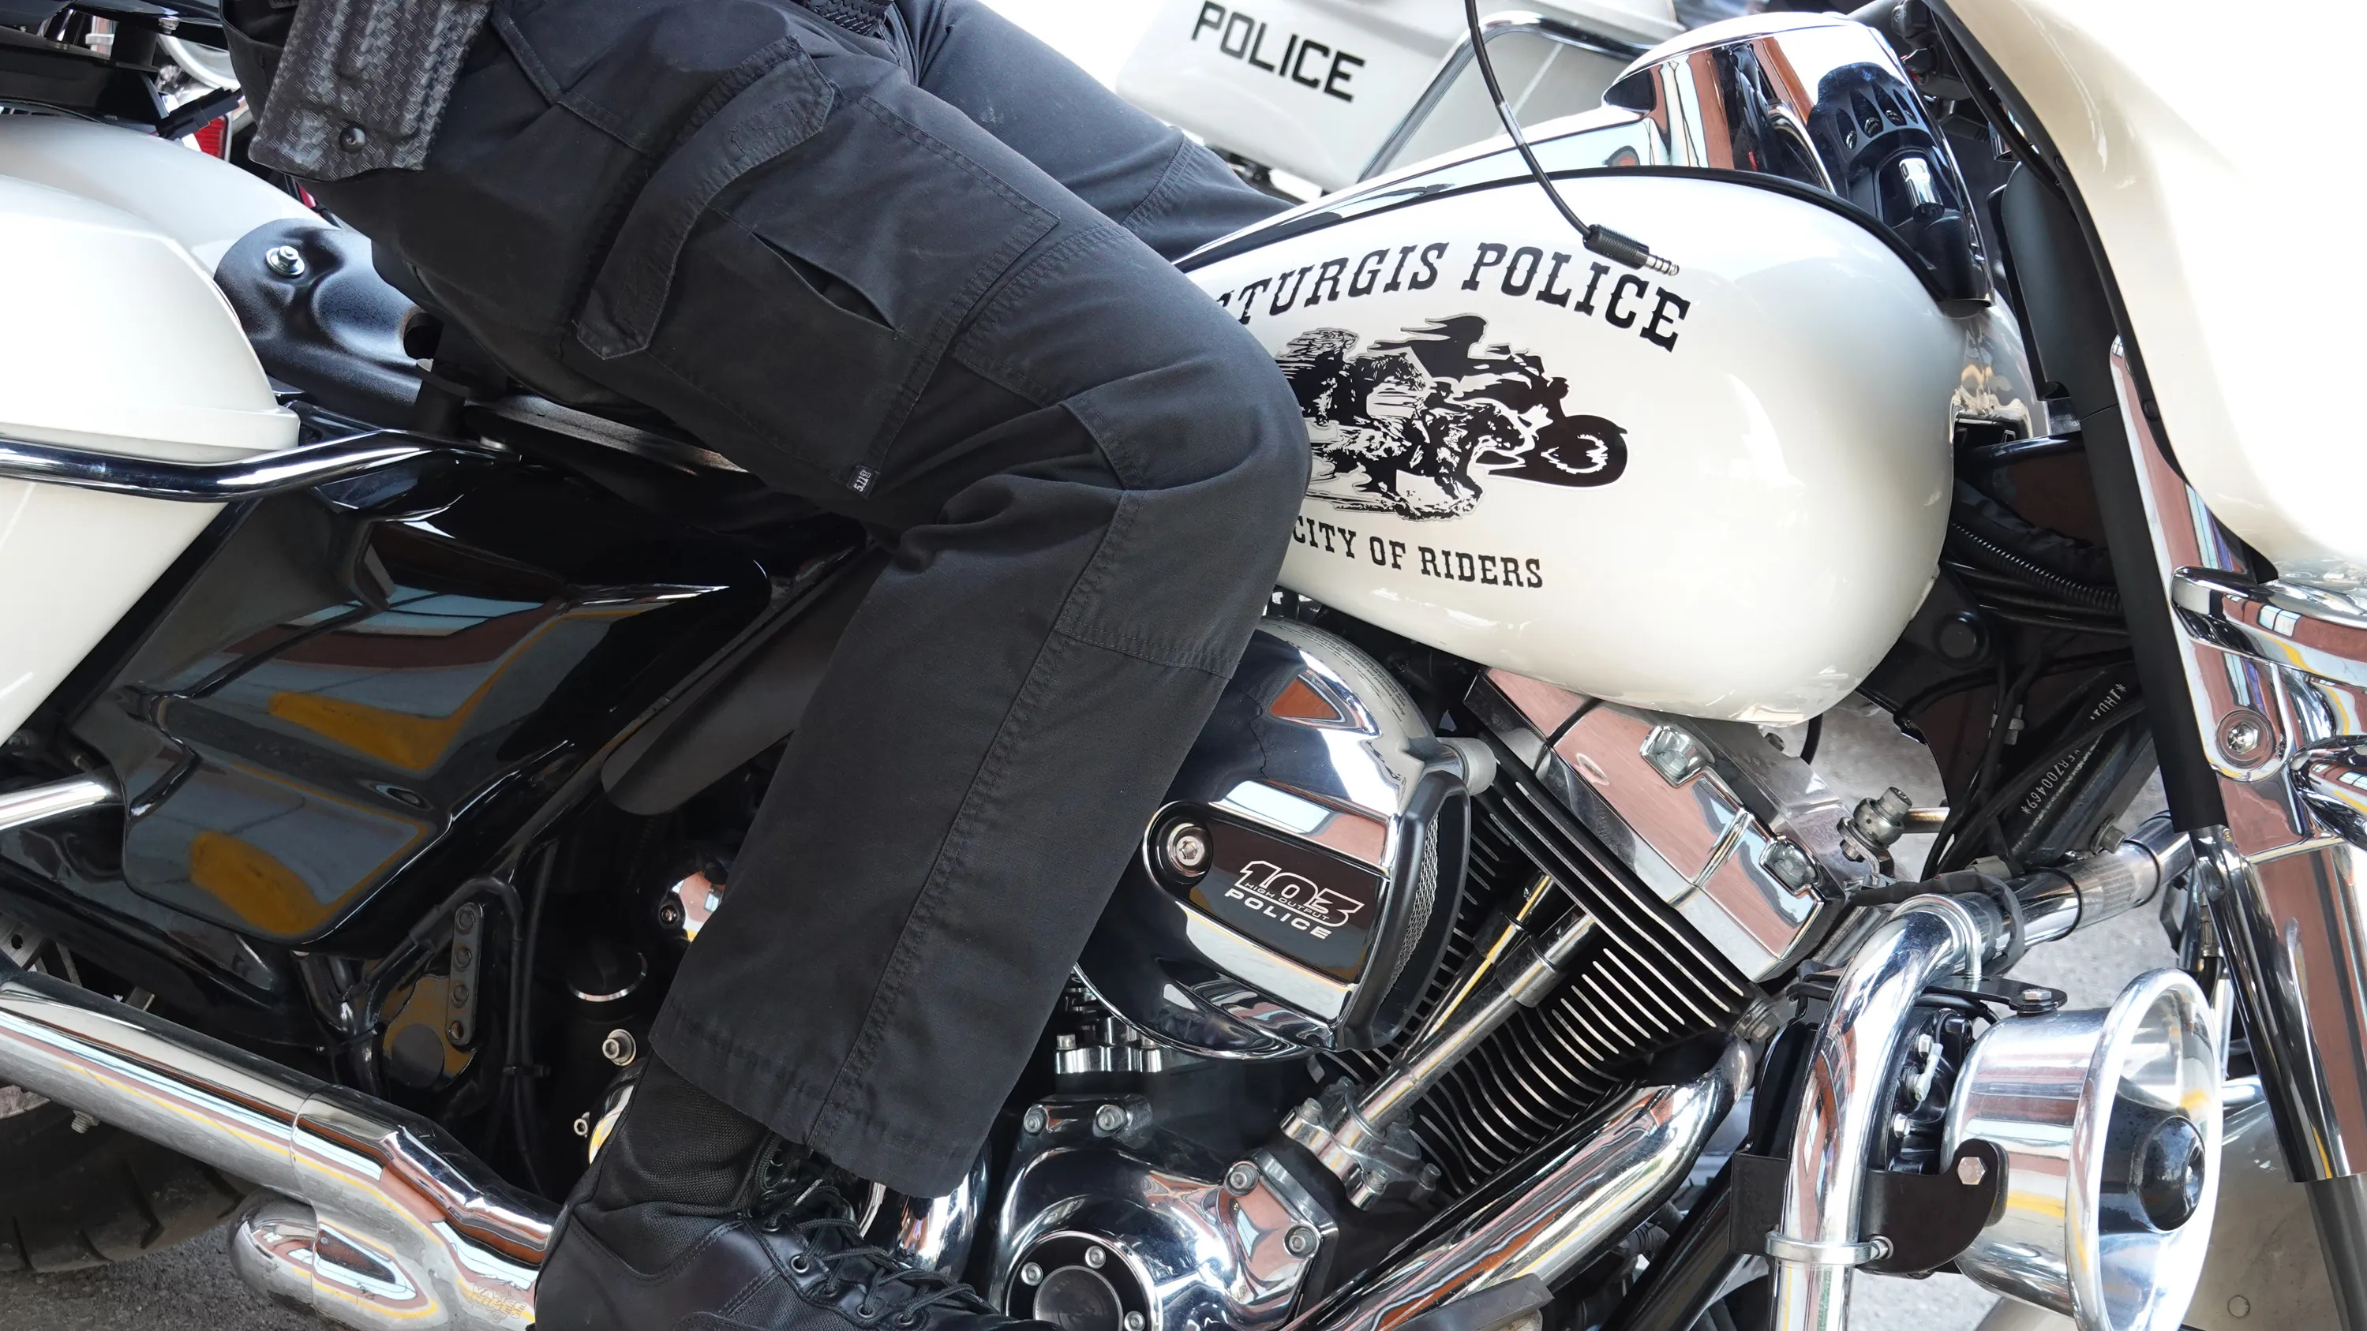
Objectives Achieved for 2025 Rally
Increased efficiency across all state radio sites, decrease busies, and eliminate congestion using tactical technical solutions
State Radio expanding leadership role
New Rally Communications Plan created with stakeholders' input
Transparency in challenges, potential technical solutions, and better coordination and outreach to stakeholders
Enhanced monitoring and feedback to stakeholders during the rally
Enhancing communication with stakeholders to ensure understanding of the mission
Expand partnerships with agencies and vendors

Slide 8
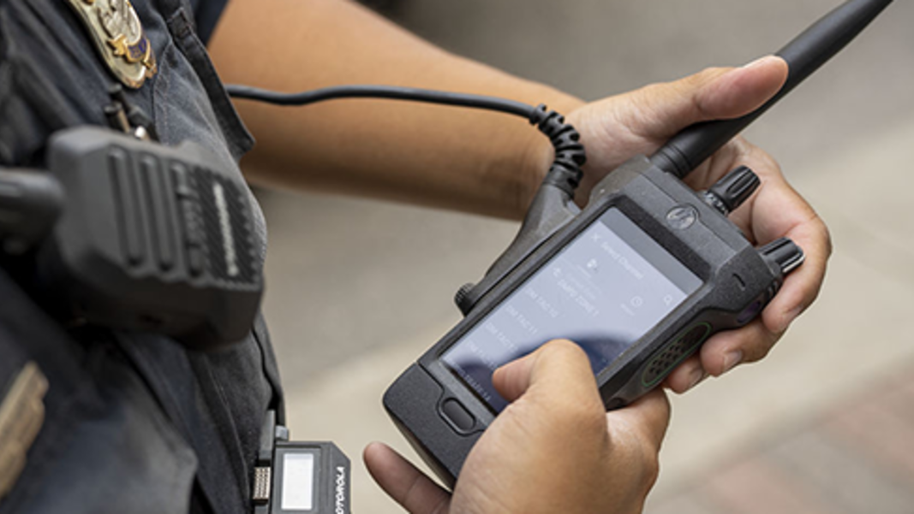
Tactical technical changes for 85th Rally
Added 2 additional voice channels to Sturgis state radio site increases capacity by 67% completed in April 2025
Added Zetron Max Gateway with two Smart Connect Radios for dispatch to communicate with restricted interop Talkgroups PCSO to MCSO Dispatch(newly created talkgroup) and PC Fire
Talkgroup prioritization to ensure highest priority Talkgroups have resources during high utilization
Faith Stock show comms moved to Special Ops 6
DOT use Smart Connect cache radios
SDHP Smart Connect capabilities to communicate to all resources (restricted, unrestricted, Conventional RF)
DCI primarily using Siyata LTE devices with Critical Connect
Sturgis Conventional system for portable Sturgis PD radios (foot patrol)
Meade COSO purchased 16 Motorola APX N70 radio with full LTE/Wi-Fi/VHF capabilities
FirstNet provided 40 LTE devices with state radio talkgroups programmed into them
Motorola provided 30 Demo APX Next Radios with full LTE/RF/WiFi integration capabilities. State Radio programmed and optimize devices based upon RSSI level to affiliate seamlessly between RF, LTE, and WiFi.
Cirrus Central Management/Aware – Enhanced system wide performance and location monitoring
Genesis for detailed reporting in real time

Slide 9

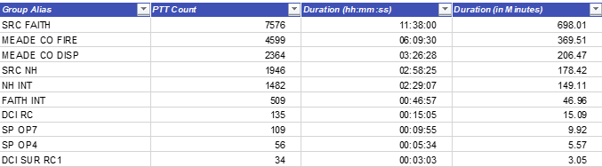
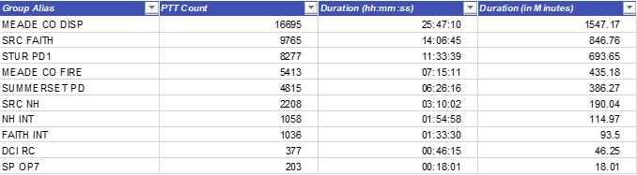
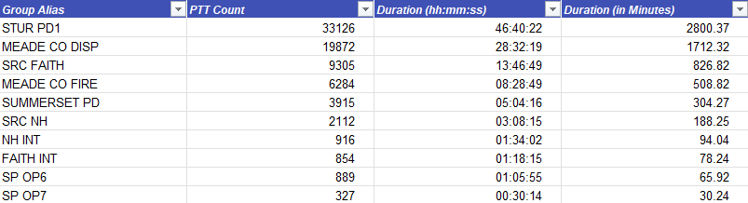
3-year trends (Top 10 Talkgroups Sturgis site)=294% increase in State Radio traffic
2023
2024
2025

Slide 10
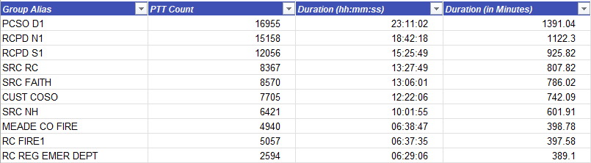
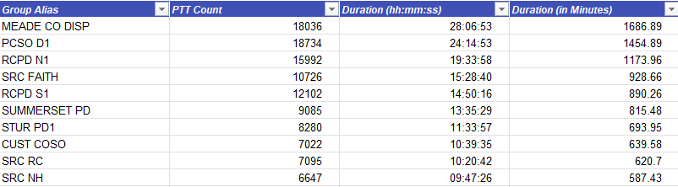
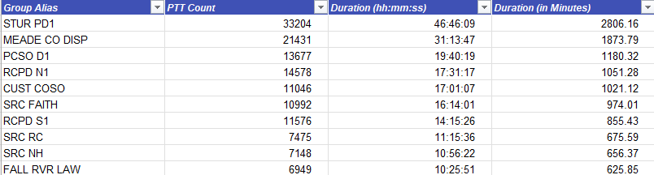
3-year trends (Top 10 Talkgroups RC Simulcast, Mt. Coolidge, Terry Pk, Bear Mtn, Edgemont, Enning, Faith, Sturgis, Wall, Castlerock, Hills Simulcast, Hot Springs)= 55% increase in State Radio traffic
2023
2024
2025

Slide 11
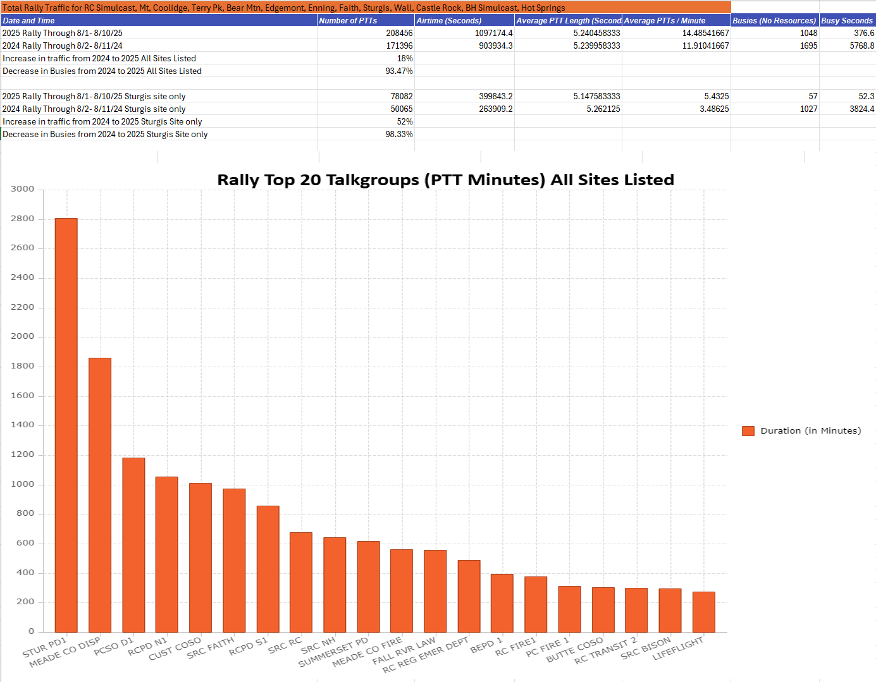
Overview Comparison between 2024 and 2025 State Radio Sturgis Rally Traffic

Slide 12
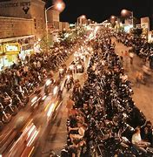
Objectives for 2026 Rally
Continuous improvement in technical capabilities
ISSI auto roam activation between South Dakota, Wyoming, Montana, and Nebraska agencies for enhanced cross border communications
New State Radio site in Spearfish
System wide implementation of talkgroup prioritization policy
More Smart Connect integrated console radios in Meade County dispatch to increase efficiency (Summerset PD)
More Smart Connect capable radios in the field
Increased vendor support with cache devices and sandbox new technologies
“Set it and forget it” site access Rally restrictions
Continue to build stakeholder confidence in state radio capabilities through relationship-building and transparency
Expanded understanding of stakeholder challenges with proposed solutions
Expand local vendor involvement and support
Investment in technological solutions at a local level
Develop 5-year plan for Annual Motorcycle Rally

Slide 13
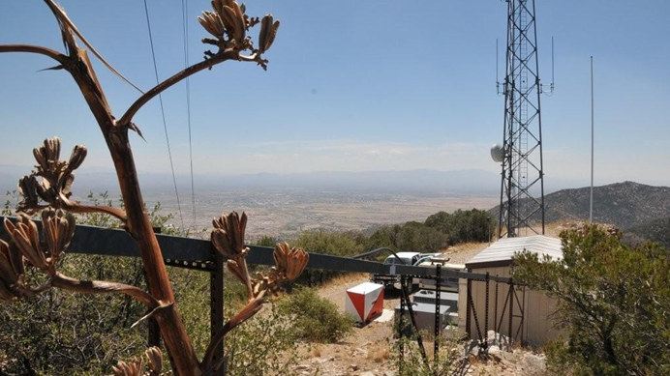
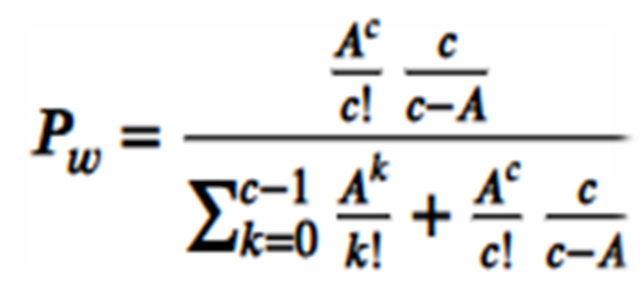
New Business (continued)
5. Grade Of Service Standard for State Radio
  Grade of Service(GoS)- summarized activity for the system's busiest hour of the specified time range (by site).
  Offered Load (Er)-an Erlang is a unit of traffic load representing the average number of simultaneous calls active or channels busy over a specific period, typically the "busy hour". It quantifies the demand placed on a radio system by users, indicating how many channels would be in continuous use if there were no blocking or delay. For example, 1 Erlang means one channel is kept busy for one hour, or the equivalent of 3,600 seconds of call time per hour.
  Erlang C formula- Pw=Probability that a call waits, A=total offered Erlangs, c=number of available channels
  Actual GoS-Percent of requests that resulted in unacceptable busies for these sites.
  Represents the busiest time of a site based upon a certain timeframe.
  Used as a prediction tool to evaluate site efficiency and identify constrained resources within the State Radio infrastructure.
  Identified constrained resources become high priority for tactical technical intervention by State Radio.
  State Radio excellence standard is 2% GoS with a <1 second acceptable wait time.
  This means that for an average busy period or full channel utilization - 98% of Push To Talks will not be delayed by 1 second.

Slide 14


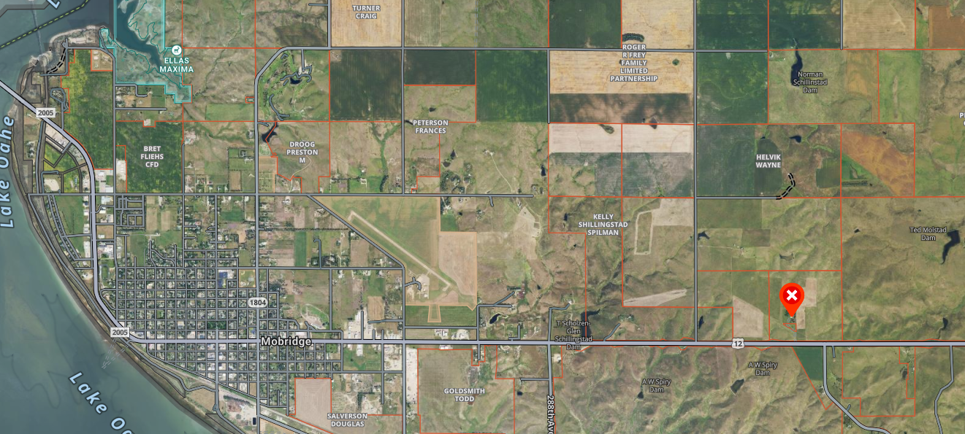
New Business (continued)
6. Walworth County Radio Survey and Formula For Underserved Areas – Jeff Jensen (EM Walworth County)
  Completed radio surveys sent out by State Radio
  Radio Coverage Challenges/LTE Challenges
  Tested FirstNet, Verizon, and T-Mobile – all have issues with coverage
  Identified good location for new state radio site owned by MDU
  Offered site at no cost for public safety
  Walworth County seeking funds to retrofit tower to support State Radio antennas and feedlines ($37,290) and new shelter ($25,000)
  Increases Formula for Underserved Areas score from 93 to 124
  Explore funding options for remaining $450,000 if PSCC supports moving forward

Slide 15
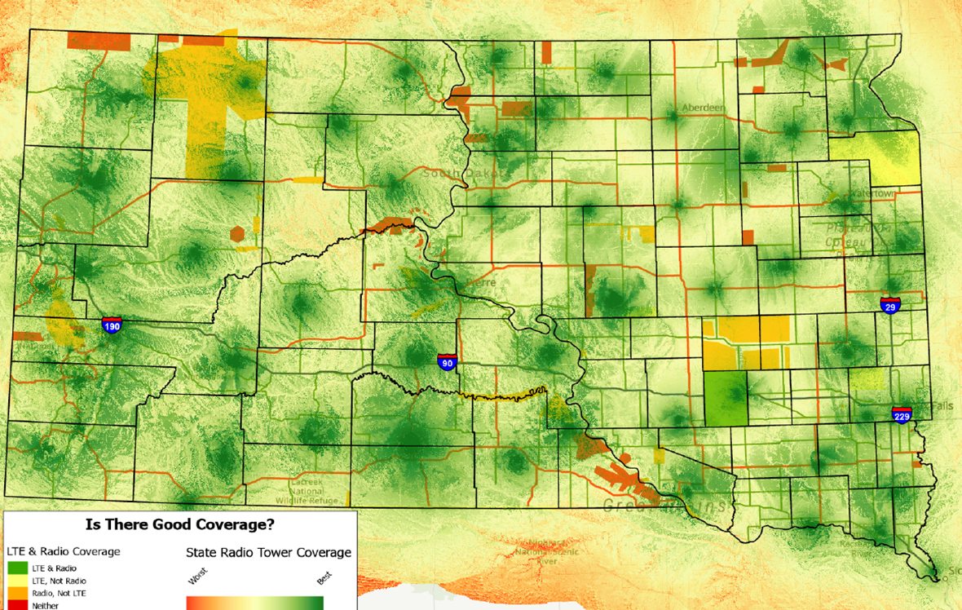
New Business (continued)
7. FirstNet buildout focus group
  Formed focus group to review FirstNet Areas of Interest (AOI’s)
  Identify areas in South Dakota where LTE and RF services are challenges
  Sent surveys to stakeholders
  Ground truth data
  Prioritization
  Provide findings of focus group to all LTE providers in October using Formula for Underserved Areas
  Five-year plan obligation

Slide 16

Organizational Reports
Organization Reports
Police Chiefs Assn. – Jeremy Wellnitz
Sheriff’s Assn – Steve Swenson
DCI/Attorney General – Preston Patterson
GFP – Bruce Nachtigall
DOT – Brian Wacholz
National Guard – David Goodwin
Emergency Managers – Pat Harrington
Firefighters – Charlie Kludt
Healthcare – Jacob Parsons
Highway Patrol – Micheal Peterson
APCO/NENA – Mary Shoemaker
EMT – Robert Rendon
Wildland Fire – Ray Black
County Commissioners – Kade Haley
Health Department – Danielle Daak
Tribal Governments – Tommy Thompson
Federal Government – Andy Barth
BIT Engineering – Trent Nincehelser
SD Senate – Randy Deibert
SD House of Representatives – Kevin Van Diepen
911 – Jason Husby
Closing Comments
Vice-chair – Michael Peterson
Member at Large - Vacant
Chair – Bruce Nachtigall
Next Meeting: date, time, location – Tentative December 10th, 2025

